Slide 1

추세추종
2017년 4월 12일 수요일
정다운

Slide 2
추세추종
주식에서 큰 실패를 하는 이유는 장세에 따라 주식 비중을 조절하지 못했기 때문
싼 가격에 사서 비싼 가격에 팔아야 수익이 나는 것은 옳음
우리는 주가를 예측하지 못해도 정해놓은 기준에 따라 상승장과 하락장을 구분
추세
추세는 일종의 관성, 움직임의 방향성이 변하지 않고 계속 유지되려는 성질
오르는 주식은 계속 오르고, 떨어지는 주식은 계속 떨어지려는 속성 있음
주가 하락시 매수할 경우 전에 비해 싼것은 맞지만, 매수 후 주가는 더 하락할 것이기에 사실은 비싸게 산것
주가의 방향성이 언제 바뀔지는 알 수 없으나, 적어도 그 방향성이 바뀌기 전까지는 일반적으로 추세가 유지되는 속성 있음
주가가 싸다, 비싸다는 기준은 개인이 정하기 나름

Slide 3
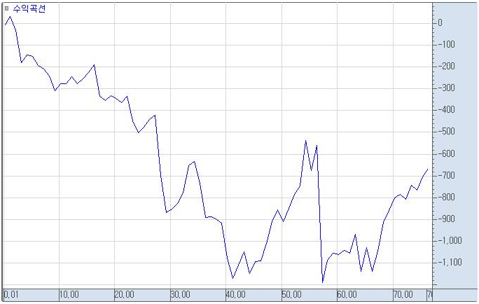
추세추종
당일 주가가 최근 20일 간의 최저가보다 낮으면 ‘싸다‘, 최근 20일 최고가보다 높으면 ‘비싸다’
전략 1 : 당일 주가가 최근 20일 최저가보다 낮은 경우 매수, 최고가보다 높은 경우 매도

Slide 4
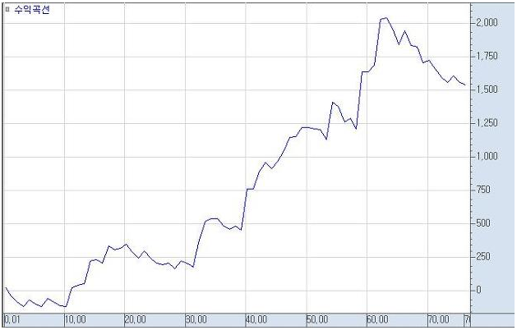
추세추종
전략 2 : 당일 주가가 최근 20일 최고가보다 높은 경우 매수, 최저가보다 낮은 경우 매도
전략 1은 장기적으로 76% 손실 발생, 전략 2는 장기적으로 674% 수익

Slide 5
추세추종
장기적 추세 따라 매매하는 방법이 수익을 주는 이유는 큰 추세가 한 번 지속되면 그 움직임의 폭은 제한이 없기 때문, 즉 수익이 날 때 큰 추세를 만나면 수익의 폭에는 제한이 없음
추세 방향에 반하는 매매의 경우 횡보구간의 수익은 제한되어 있고, 손실이 날 때는 손실의 폭에 제한이 없는 구조

Slide 6
추세추종
구조적으로 추세를 따르는 매매는 손실은 제한된 반면, 수익은 무한대로 열려있음
추세를 거스르는 (쌀 때 사서, 비쌀 때 파는 방법) 매매는 수익은 제한된 반면, 손실은 무한대로 열려있음
장기적으로 시장에는 커다란 추세가 반드시 나타나기 때문에 추세를 거스르는 매매는 구조적으로 손실이 누적

Slide 7
모멘텀 전략
실제 포트폴리오 투자에서 전세계적으로 널리 이용되는 ‘월간 모멘텀 전략＇이라는 추세 매매법
모멘텀
모멘텀 = 오늘 주가 – 특정 시점 이전의 주가
모멘텀 전략
모멘텀 값이 큰 종목에 투자하는 추세 추종형 전략
강하게 상승하는 종목에 추가하는 ‘상대 강도 전략‘(Relative Strength Strategy)

Slide 8
모멘텀 전략
제가디쉬와 티트만의 모멘텀 전략
상승 추세에 있는 종목들의 수익률이 하락 추세에 있는 수익률을 현저하게 초과
모멘텀/추세 효과는 비단 주식 시장에만 국한된 것이 아니라 외환, 선물, 채권, 부동산, 상품 등 모든 투자 자산 내에서, 심지어는 투자 자산간에서도 나타남
3~12개월의 어느 기간에서 일관되게 나타남
상대 모멘텀 뿐 아니라 절대 모멘텀 전략도 도움

Slide 9
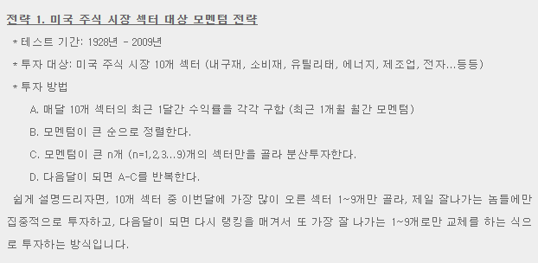
모멘텀 전략
모멘텀 전략 실례
M.faber의 상대 강도 전략에서 나온 시뮬레이션 데이터

Slide 10
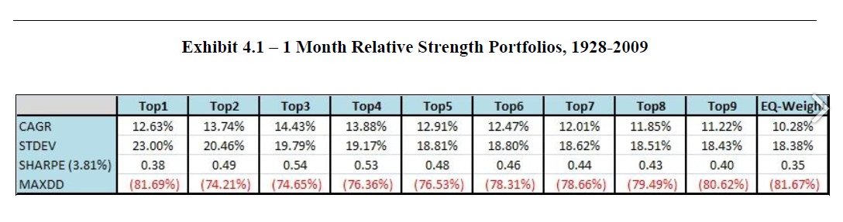
모멘텀 전략
Top1은 매달 모멘텀이 가장 강한 1종목 투자시 수익률, Top2는 두 종목, TopN은 N개 종목
1개월 모멘텀
연 평균 수익률(CAGR)은 대체적으로 모멘텀 상위 1~3 종목에 투자할 수록 하위 종목까지 포함하는 것보다 높음

Slide 11
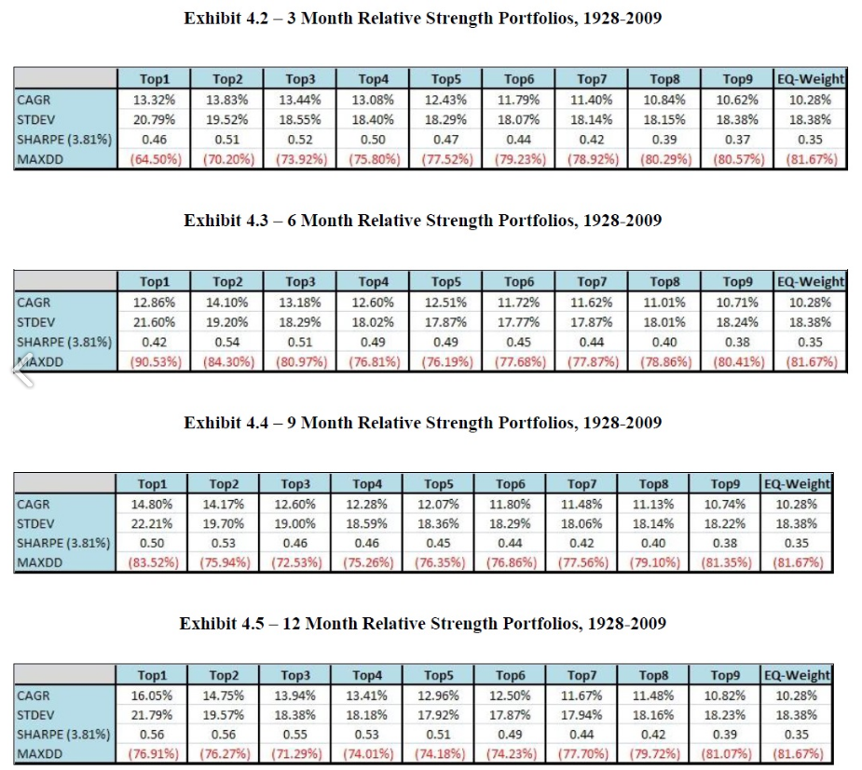
모멘텀 전략
3개월, 6개월, 9개월, 12개월 모멘텀

Slide 12
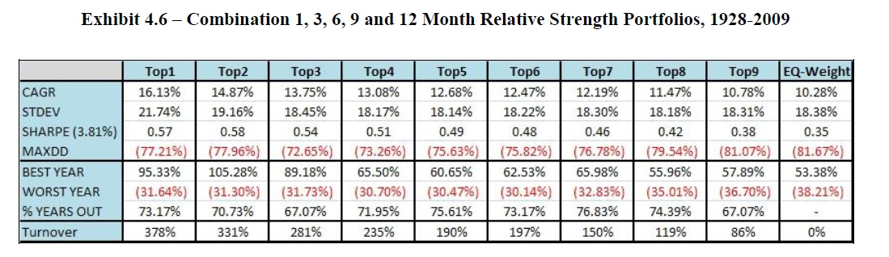
모멘텀 전략
모멘텀 기간이 길어질 수록 연평균 수익률이 높아짐
모멘텀 효과가 나타나는 기간은 1~12달의 어디에서도 나타나는 것으로 알려져 있지만, 일반적으로 6~12개월 사이의 비교적 긴 구간에서 더 뚜렷하게 나타남
1, 3, 6, 9, 12개월 평균 모멘텀 상위 종목으로 투자했을때 결과

Slide 13
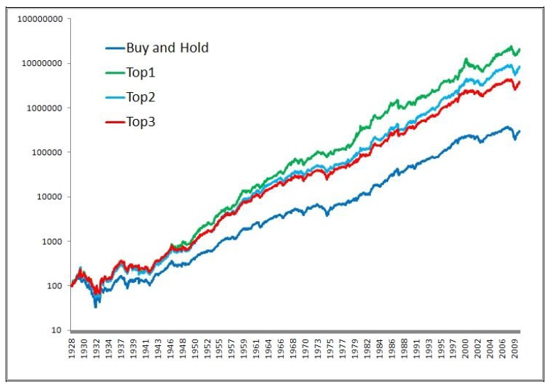
모멘텀 전략
1, 3, 6, 9, 12 개월 평균 모멘텀 상위 1, 2, 3개 섹터 선정, 누적수익률

Slide 14
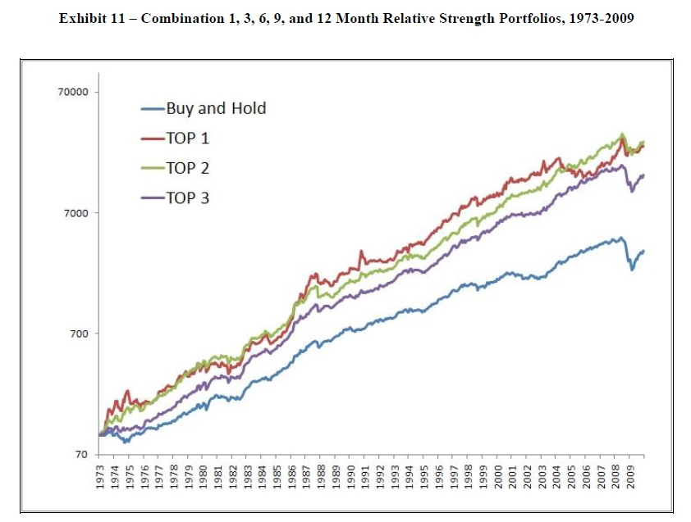
모멘텀 전략
모멘텀 효과는 서로 다른 자산간에도 똑같이 나타남
글로벌 자산간 모멘텀 투자 전략

Slide 15
모멘텀 전략
절대 모멘텀 전략
모멘텀이 0보다 작으면, 즉 하락 추세에 있는 경우는 투자하지 않고 현금으로 대체
G.antonacci의 전략
어떤 자산의 12개월 모멘텀이 0보다 크면(상승추세) 보유, 작으면 현금보유
미국 주식지수, 해외 주식지수, 국채, 회사채, 정크본드, 부동산, 금에 적용

Slide 16
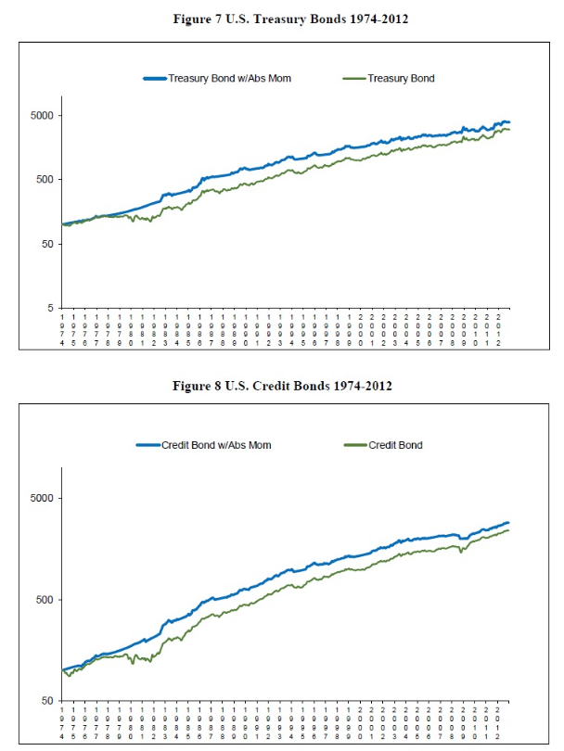
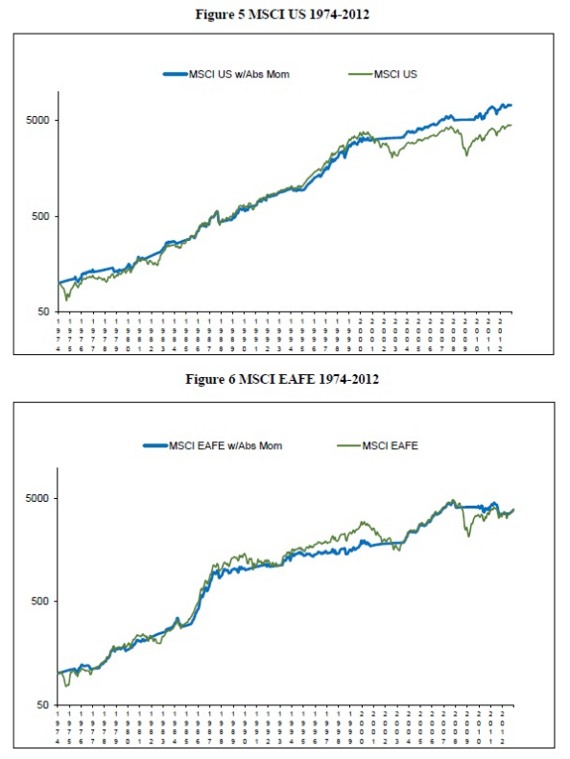
모멘텀 전략

Slide 17
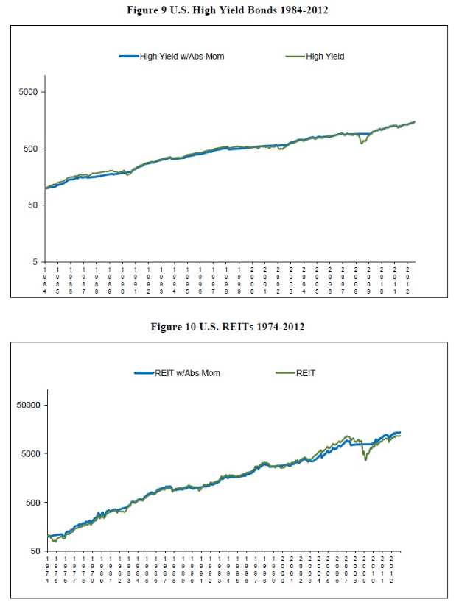
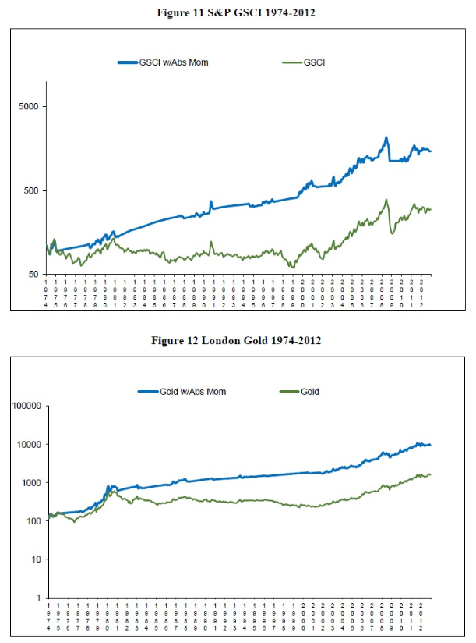
모멘텀 전략

Slide 18
모멘텀 전략
자산이 하락 추세인 경우 빠져나오기 때문에, 하락장에서의 손실을 방어하면서도 높은 수익을 확보
절대 모멘텀이 0인 경우 투자하지 않는 것은 일종의 ‘손절매＇와 같은 기능
듀얼 모멘텀 전략
여러 자산군에서 모멘텀 기준으로 랭킹을 매겨서 상위 몇종목을 골라 투자하되, 선택된 자산의 모멘텀이 마이너스이면 그 자산은 현금으로 대치하면 손실과 변동성을 더 줄일 수 있음

Slide 19
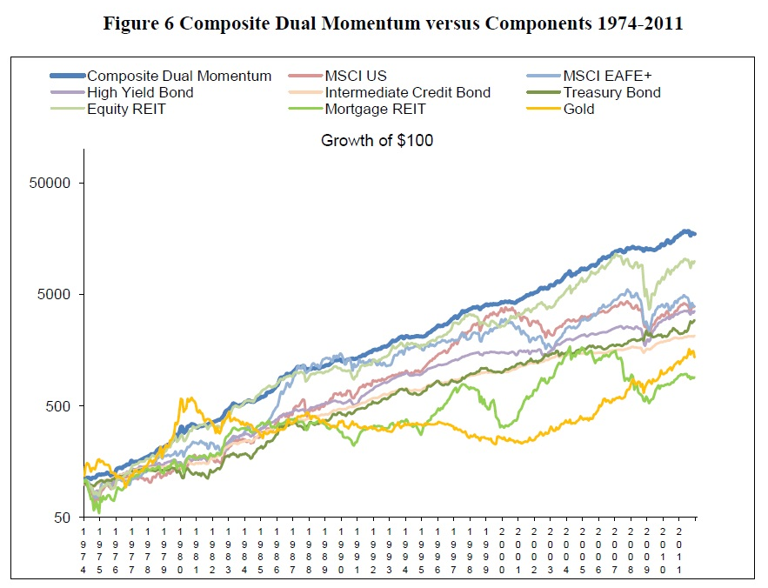
모멘텀 전략
듀얼 모멘텀 전략의 최근 30년간 수익곡선

Slide 20
모멘텀 전략
듀얼 모멘텀 전략이 시장의 상황과 무관한 절대 수익 전략처럼 보이는 이유는 시장의 상황에 충실히 따랐기 때문
시장의 상황과 무관하게 ‘수익’만을 추구하기 때문

Slide 21
논문발표
Title
Predicting stock and stock price index movement using Trend Deterministic Data Preparation and machine learning techniques
Year Published
2015
Authors
Jigar Patel, Sahil Shah, Priyank Thakkar, K Kotecha
Journal
Expert Systems with Applications
Volume, Issue number, Pages
Volume 42, Issue 1, Pages 259–268

Slide 22
목차
Information
Concepts
Introduction
Research data
Feature
ANN model
SVM model
Random forest model
Naïve-Bayes model(Gaussian)
Experimental results
Conclusion

Slide 23
Concepts
Predicting stock and stock price index is difficult due to uncertainties involved.
There are two types of analysis which investors perform before investing in a stock.
First is the fundamental analysis.
In this, investors looks at intrinsic value of stocks, performance of the industry and economy, political climate etc. to decide whether to invest or not.
On the other hand, technical analysis
Technical analysis is the evaluation of stocks by means of studying statistics generated by market activity, such as past prices and volumes.
Technical analysts do not attempt to measure a security’ s intrinsic value but instead use stock charts to identify patterns and trends that may suggest how a stock will behave in the future.

Slide 24
Introduction
This paper addresses problem of predicting direction of movement of stock and stock price index for Indian stock markets.
The study compares four prediction models, Artificial Neural Network (ANN), Support Vector Machine (SVM), random forest and naive-Bayes with two approaches for input to these models.

Slide 25
Introduction
The first approach for input data involves computation of ten technical parameters using stock trading data (open, high, low & close prices) while the second approach focuses on representing these technical parameters as trend deterministic data.
Accuracy of each of the prediction models for each of the two input approaches is evaluated.
Evaluation is carried out on 10 years of historical data from 2003 to 2012 of two stocks namely Reliance Industries and Infosys Ltd. and two stock price indices CNX Nifty and S&P Bombay Stock Exchange (BSE) Sensex.

Slide 26
Introduction
The experimental results suggest that for the first approach of input data where ten technical parameters are represented as continuous values, random forest outperforms other three prediction models on overall performance.
Experimental results also show that the performance of all the prediction models improve when these technical parameters are represented as trend deterministic data.
This study focuses on comparing prediction performance of ANN, SVM, random forest and naive-Bayes algorithms for the task of predicting stock and stock price index movement. Ten technical parameters are used as the inputs to these models.

Slide 27
Research data
Ten years of data of total two stock price indices (CNX Nifty, S&P BSE Sensex) and two stocks (Reliance Industries, Infosys Ltd.) from Jan 2003 to Dec 2012 is used in this study.
All the data is obtained from <http://www.nseindia.com/> and <http://www.bseindia.com/> websites.

Slide 28
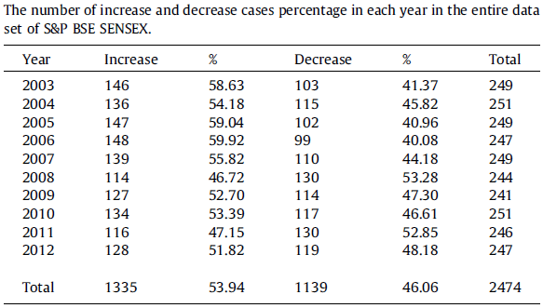
Research data
These data forms our entire data set.
Percentage wise increase and decrease cases of each year in the entire data set are shown in Table

Slide 29
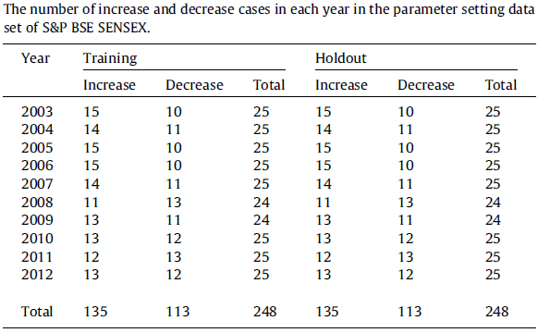
Research data
This study uses 20% of the entire data as the parameter selection data.
This data is used to determine design parameters of predictor models.
This parameter selection data is further divided into training and hold-out set. Each of the set consists of 10% of the entire data.

Slide 30
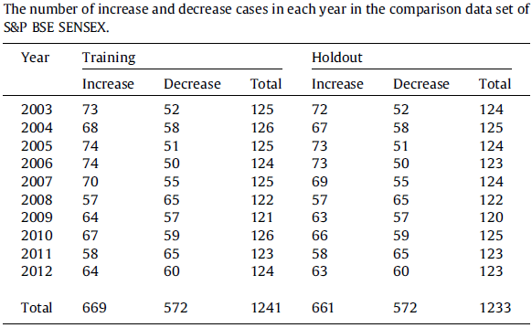
Research data
Optimum parameters for predictor models are obtained by means of experiments on parameter selection data.
After that, for comparing ANN, SVM, random forest and naive-Bayes, comparison data set is devised. This data set comprises of entire ten years of data.
It is also divided in training (50% of the entire data) and hold-out (50% of the entire data) set.

Slide 31
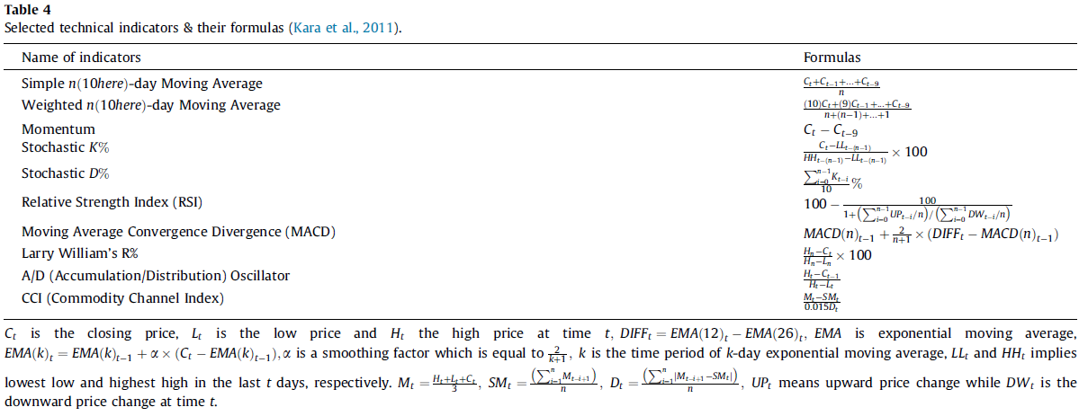
Research data

Slide 32
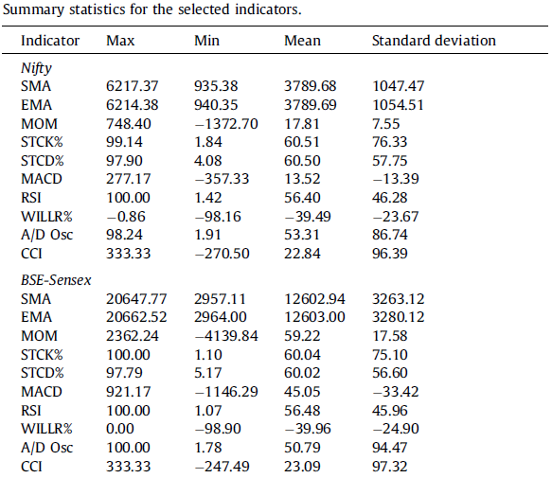
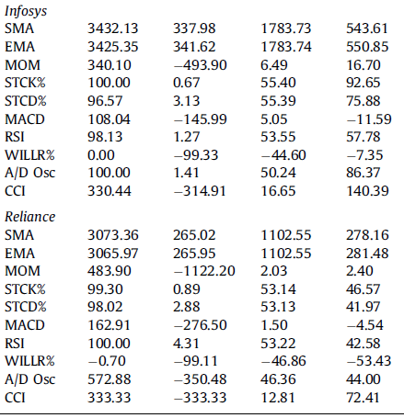
Research data

Slide 33
Feature
1. SMA(Simple n(10gere)-day Moving Average)
10 days’ Simple Moving Average
2. EMA(Weighted n(10here)-day Moving Average)
Weighted Moving Average
First two technical indicators are moving averages. The moving average (MA) is simple technical analyses tool that smoothies outprice data by creating a constantly updated average price.
Used as we are predicting short term future.
If current price is above the moving average values then the trend is ‘up’ and represented as ‘+1’, and if current price is below the moving average values then the trend is ‘down’ and represented as ‘-1’.

Slide 34
Feature
3. MOM(Momentum)
10 days’ Simple Moving Average
Momentum measures the rate of rise and fall of stock prices.
Positive value of momentum indicates up trend and is represented by ‘+1’ while negative value indicates down trend and is represented as ‘-1’.

Slide 35
Feature
4. STCK%(Stochastic K%)
5. STCD%(Stochastic D%)
6. Williams R%(Larry William’s R%)
STCK%, STCD% and Williams R% are stochastic oscillators.
These oscillators are clear trend indicators for any stock.
When stochastic oscillators are increasing, the stock prices are likely to go up and vice-a-versa.
This implies that if the value of stochastic oscillators at time ‘t’ is greater than the value at time ‘t-1’ then the opinion of trend is ‘up’ and represented as ‘+1’ and vice-a-versa.

Slide 36
Feature
7. MACD(Moving Average Convergence Divergence (MACD))
MACD follows the trend of the stock, i.e. if MACD goes up then stock price also goes up and vice-a-versa.
So, if the value of MACD at time ‘t’ is greater than the value at time ‘t-1’, opinion on trend is ‘up’ and represented as ‘+1’ and if the value of MACD at time ‘t’ is less than value at time ‘t-1’, opinion on trend is ‘down’ and represented as ‘-1’.

Slide 37
Feature
8. RSI(Relative Strength Index (RSI))
RSI is generally used for identifying the overbought and oversold points.
It ranges between 0 and 100.
If the value of RSI exceeds 70 level, it means that the stock is overbought, so, it may go down in near future (indicating opinion ‘-1’) and if the value of RSI goes below 30 level, it means that the stock is oversold, so, it may go up in near future (indicating opinion ‘+1’).
For the values between (30, 70), if RSI at time ‘t’ is greater than RSI at time ‘t-1’, the opinion on trend is represented as ‘+1’ and vice-a-versa.

Slide 38
Feature
8. RSI(Relative Strength Index (RSI))
RSI is generally used for identifying the overbought and oversold points. It ranges between 0 and 100.
If the value of RSI exceeds 70 level, it means that the stock is overbought, so, it may go down in near future (indicating opinion ‘-1’) and if the value of RSI goes below 30 level, it means that the stock is oversold, so, it may go up in near future (indicating opinion ‘+1’).
For the values between (30, 70), if RSI at time ‘t’ is greater than RSI at time ‘t-1’, the opinion on trend is represented as ‘+1’ and vice-a-versa.

Slide 39
Feature
9. CCI(Commodity Channel Index)
CCI measures the difference between stock’s price change and its average price change. High positive readings indicate that prices are well above their average, which is a show of strength.
Low negative readings indicate that prices are well below their average, which is a show of weakness. CCI is also used for identifying overbought and oversold levels.
In this paper we have set 200 as overbought level and -200 as oversold level as 200 is more representative of a true extreme.
This means that if CCI value exceeds 200 level, the opinion for the trend is ‘-1’ and if it is below -200 level then the opinion for the trend is ‘+1’. For the values between (-200, 200), if CCI at time ‘t’ is greater than CCI at time ‘t-1’, the opinion on the trend is ‘+1’ and vice-a-versa.

Slide 40
Feature
10. A/D (Accumulation/Distribution) Oscillator
A/D oscillator also follows the stock trend meaning that if its value at time ‘t’ is greater than that at time ‘t-1’, the opinion on trend is ‘+1’ and vice-a-versa.

Slide 41
Feature
In nutshell, trend deterministic data is prepared by exploiting the fact that each of the technical indicators has its own inherent opinion about the stock price movement.
When we give these data as inputs to the model as opposed to their actual continuous value, we are already inputting trend information as perceived by each of the individual technical indicators.
This is a step forward in a sense that now prediction models have to determine correlation between the input trends and the output trend.
Using these indicator values, the trend deterministic input set is prepared and given to the predictor models.
Performance of all the models under study is evaluated also for this representation of inputs.

Slide 42
ANN model
ANN(Artificial Neural Networks)
An artificial neural network is composed of many artificial neurons that are linked together according to a specific network architecture.
The objective of the neural network is to transform the inputs into meaningful outputs.
Output
Inputs

Slide 43
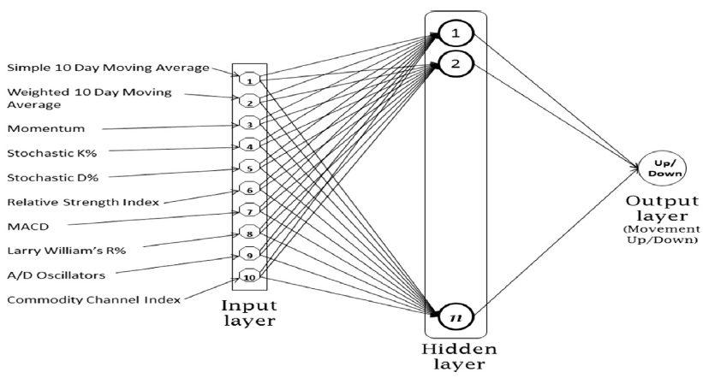
ANN model

Slide 44
ANN model
A three layer feed-forward neural network is employed in our study.
Inputs for the network are ten technical indicators which are represented by ten neurons in the input layer.
Output layer has a single neuron with log sigmoid as the transfer function. This results in a continuous value output between 0 and 1. A threshold of 0.5 is used to determine the up or down movement prediction. For the output value greater than or equal to 0.5, prediction is considered to be the up movement else the down movement.

Slide 45
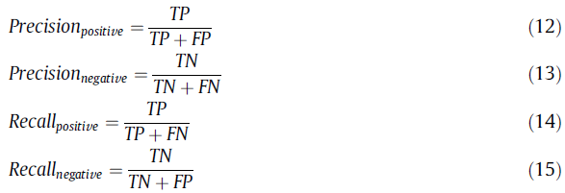
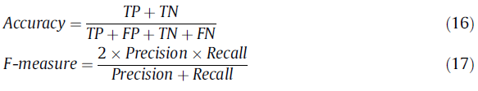
Experimental results

Slide 46
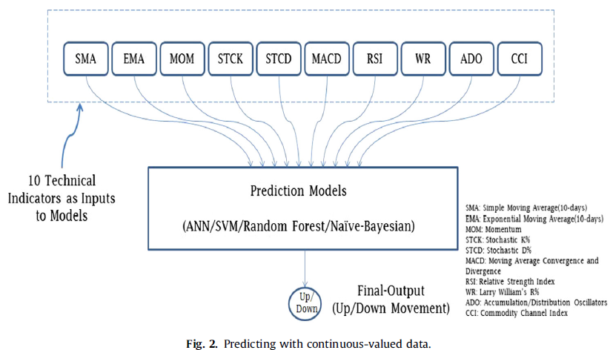
Experimental results

Slide 47
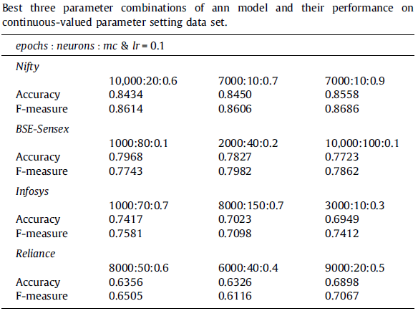
Experimental results
Parameters Level(s)
Number of hidden layer neurons(n) 10,20,…,10,000
Epochs(ep): 반복 횟수 1000,2000,…,10,000
Momentum constant(mc):모멘텀상수 0.1,0.2,…,0.9
Learning rate(lr):학습속도 0.1

Slide 48
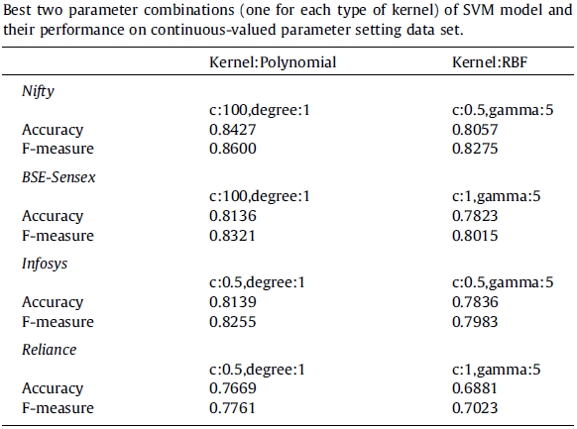
Experimental results
Parameters Levels(polynomial) Levels(radial basis)
Degree of kernel function(d) 1,2,3,4 -
Gamma in kernel function(y) - 0.5,1.0,1.5,…,5.0,10.0
Regularization parameter(c) 0.5,1,5,10,100 0.5,1,5,10

Slide 49
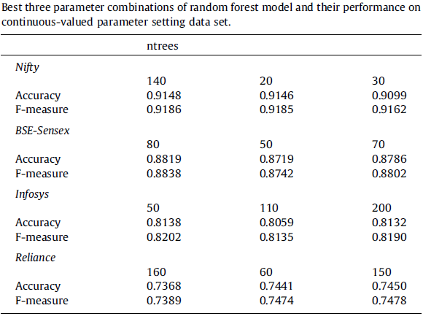
Experimental results

Slide 50
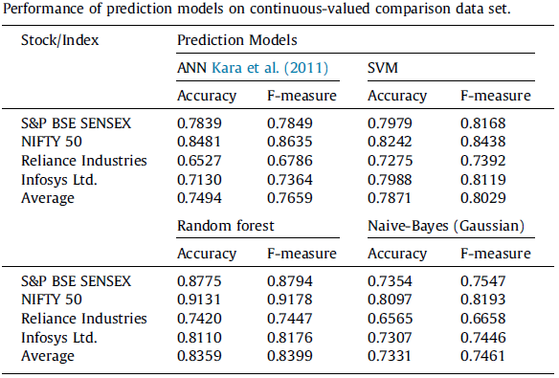
Experimental results

Slide 51
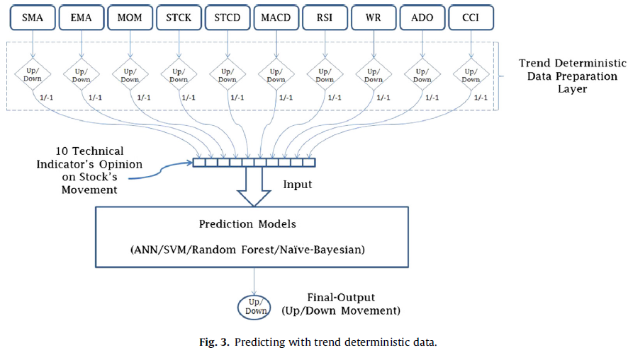
Experimental results

Slide 52
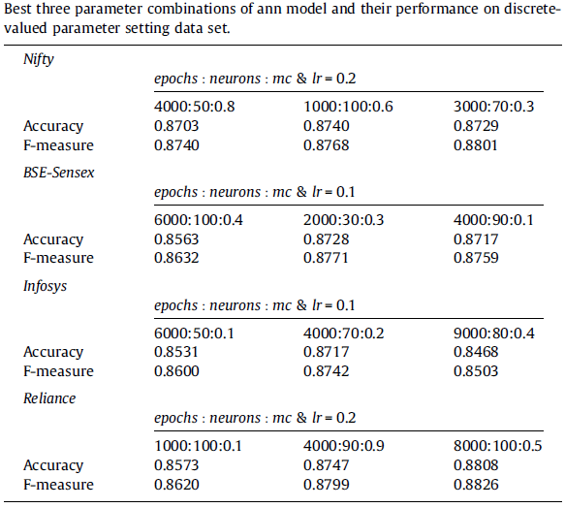
Experimental results

Slide 53
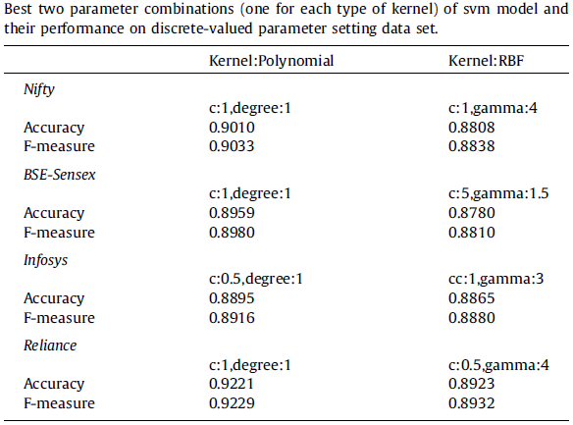
Experimental results

Slide 54
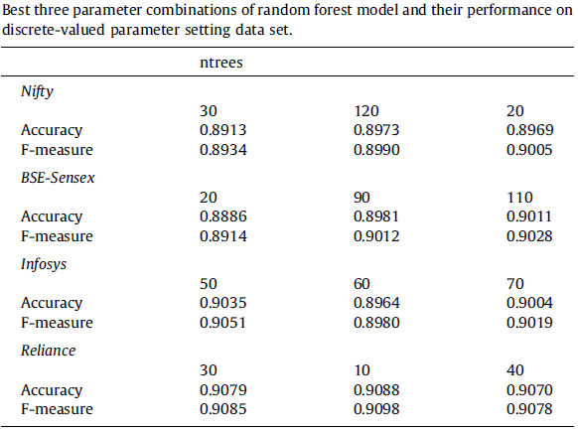
Experimental results

Slide 55
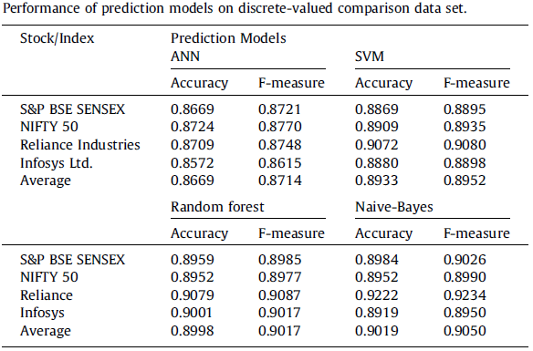
Experimental results

Slide 56
Conclusion
The task focused in this paper is to predict direction of movement for stocks and stock price indices.
Prediction performance of four models namely ANN, SVM, random forest and naive-Bayes is compared based on ten years (2003–2012) of historical data of CNX Nifty, S&P BSE Sensex, Infosys Ltd. and Reliance Industries from Indian stock markets.
Ten technical parameters reflecting the condition of stock and stock price index are used to learn each of these models.
A Trend Deterministic Data Preparation Layer is employed to convert each of the technical indicator’s continuous value to +1 or -1 indicating probable future up or down movement respectively.

Slide 57
Conclusion
Experiments with continuous-valued data show that naive-Bayes (Gaussian process) model exhibits least performance with 73.3% accuracy and random forest with highest performance of 83.56% accuracy.
Performance of all these models is improved significantly when they are learnt through trend deterministic data.
ANN is slightly less accurate in terms of prediction accuracy compare to other three models which perform almost identically.
The accuracy of 86.69%, 89.33%, 89.98% and 90.19% is achieved by ANN, SVM, random forest and naive-Bayes (Multivariate Bernoulli Process) respectively.

Slide 58
Conclusion
Above all, success of proposed approach which is based on human approach of investing, encourages to emulate human approaches of decision making while developing expert systems and using machine learning algorithms for the problems in various other domains.

Slide 59
감사합니다

